Slide 1

Air Canvas
Team Python thinkers

Slide 2

Team Members
Anto Francis (C0825095)
Omer Volkan Guney (C0831373)
Rupesh Chandran (C0826779)
Sachin Sreekumar (C0825096)
Reporting Week: 29nd Jan 2022 – 4th Feb 2022
Supervised by
Prof. Parissa Naraei

Slide 3
Week’s update
Researched about the necessity of using HSV instead of RGB color space
Identified the libraries required for the project
Broken down Epics into smaller tasks and assigned to each person

Slide 4
Challenges faced
Understanding the difference between RGB and HSV color spaces
01
Finding Hue Saturation Value for each colors
02

Slide 5
Learnings this week
Use of Morphological operations (Erosion a& Dilation) to remove noises
Using queues to store pixel values

Slide 6
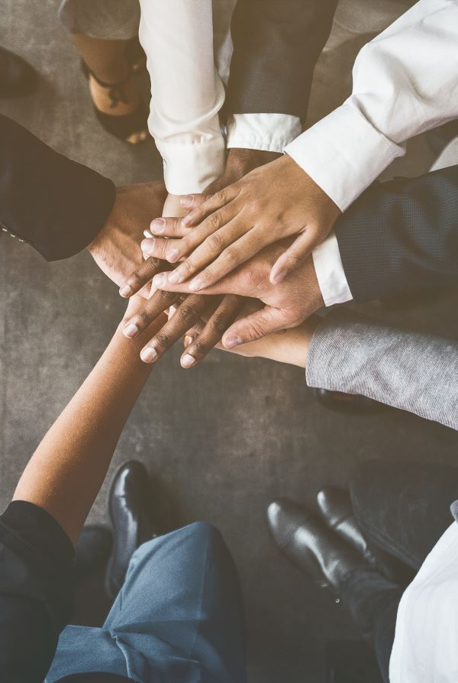
Team collaboration
Made decision about the libraries we will be using
Assigned individual tasks and decided the duration of each tasks

Slide 7
Task outline for next week
Final week of planning phase
Install necessary packages and softwares
Setup git repository
Get Jira and Slack ready for project management and internal communication

Slide 8

Thank you

